Slide 1
Using the fx-83/85GT CW for number
Calculator functionality

Slide 2
How our teaching resources are designed for the classroom

Slide 3
I can use the fx-83/85GT CW to perform calculations with numbers.

Slide 4
A factor is a term which exactly divides another term.
Prime factors are the factors of a number that are, themselves, prime.
The lowest common multiple is the lowest number that is a multiple of two or more numbers.
The highest common factor of two or more integers which can be divided by all other possible common factors.
A recurring decimal is one that has an infinite number of digits after the decimal point.

Slide 5

Using the fx-83/85GT CW for number
Conversions
LCM/HCF

Slide 6
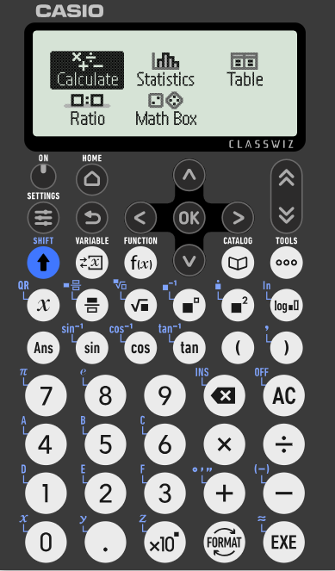
Conversions
In this lesson, we will be using the Casio fx-83/85GT CW model.
We will cover how to use this calculator to carry out different calculations.
After switching the calculator on, you will see this screen.

Slide 7
Conversions
You can use the arrow keys to navigate between the options. For now, we are going to focus on ‘Calculate’.
Press the ‘EXE’ button.

Slide 8
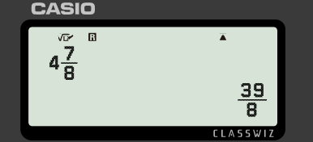

Conversions
Inputting a mixed number into the calculator and pressing ‘EXE’ returns the same value but as an improper fraction.

Slide 9

Conversions
What does inputting an improper fraction into the calculator and pressing ‘EXE’ return?
The same improper fraction
The same value but as a mixed number
The same value but as a decimal

Slide 10




Conversions
So how can I change between improper fractions and mixed numbers?
You need to use the button.
Aisha
Sam

Slide 11
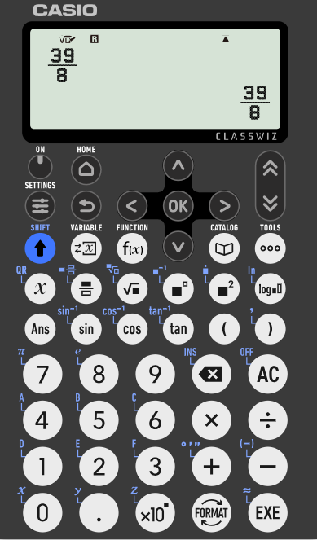
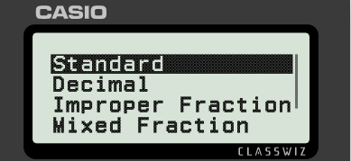
Conversions
When an improper fraction is displayed, you can change the format of the value by pressing the ‘FORMAT’ button.
The value can be displayed as a decimal, improper fraction or mixed fraction.

Slide 12

Conversions
Using your calculator, select the correct equivalent decimal form for
25.94237096
25.94236269
25.94230769

Slide 13
Conversions
Is there more that my calculator can convert?
Yes! You can also convert with time.
Aisha
Sam

Slide 14
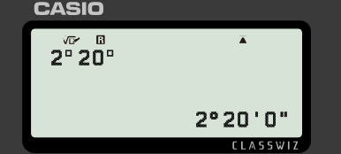


Conversions
Change 2 hours and 20 mins into hours.
Pressing the ‘SHIFT’ button, followed by the ‘+’ allows us to write in the form ‘hour, minute, second’.

Slide 15
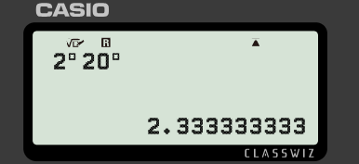

Conversions
Change 2 hours and 20 mins into hours.
Pressing the ‘FORMAT’ key allows you to display the time in different ways.

Slide 16
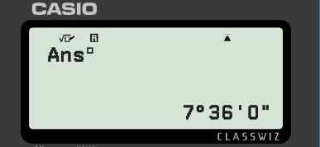
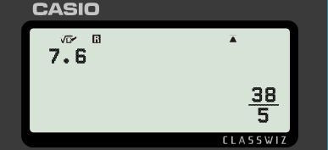

Conversions
A value in hours can be converted into hours, minutes and seconds.
Pressing the ‘SHIFT’ button, followed by the ‘+’ converts to the form ‘hour, minute, second’.
7.6 hours = 7 hours and 36 minutes (0 seconds)

Slide 17
Conversions
3.875 hours is equivalent to what time?
3 hours, 8 minutes and 8 seconds
3 hours, 45 minutes and 8 seconds
3 hours, 52 minutes and 30 seconds

Slide 18
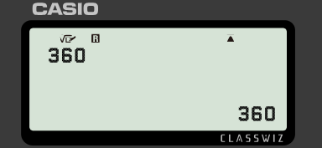

Conversions
Numbers can be written in prime factor form e.g. 49 = 7² and 124 = 2² × 31
Express 360 in prime factor form.

Slide 19
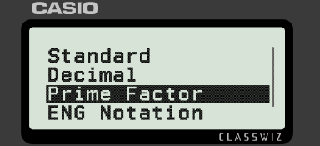
Conversions
Press ‘FORMAT’ and select ‘Prime Factor’.
Express 360 in prime factor form.

Slide 20
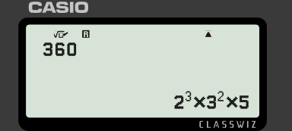
Conversions
Pressing ‘EXE’ gives the number in prime factor form.
Express 360 in prime factor form.

Slide 21
Conversions
Select the missing number: 10 375 750 = 2 × 5³ × 7 × 11²
2
3
4

Slide 22
Conversions
1) Convert the following times to hours.
a) 1 hour and 15 mins
b) 2 hours, 20 mins and 20 secs
c) 4 hours, 15 mins and 16 secs

Slide 23
Conversions
2) Convert the following number of hours to hours, minutes and seconds.
a) 7.25
b) 3.7
c) 7.42
d) 3.63

Slide 24
Conversions
3) Fill in the gaps.
a) 121 = ²
b) 5500 = 2 × ³ × 11
c) 384 = ×
d) 351 = 3 × × 13

Slide 25
Conversions
1) Convert the following times to hours.
a) 1 hour and 15 mins = 1.25
b) 2 hours, 20 mins and 20 secs = 2.338
c) 4 hours, 15 mins and 16 secs = 4.254
.
.

Slide 26
Conversions
2) Convert the following number of hours to hours, minutes and seconds.
a) 7.25 = 7 hours and 15 minutes
b) 3.7 = 3 hours and 42 minutes
c) 7.42 = 7 hours, 25 minutes and 12 seconds
d) 3.63 = 3 hours, 37 minutes and 48 seconds

Slide 27
Conversions
3) Fill in the gaps.
a) 121 = ²
b) 5500 = 2 × ³ × 11
c) 384 = ×
d) 351 = 3 × × 13
The value represented by the question marks should equal 1.
This can be done by having a base of 1 and any exponent or by having any base and an exponent of 0.
11
2
5
2
7
3
1
3
?
?

Slide 28
Using the fx-83/85GT CW for number
Conversions
LCM/HCF

Slide 29
LCM/HCF
That’s some pretty useful stuff. What else can my calculator do?
It can also find the LCM or HCF for two positive integers.
Aisha
Sam

Slide 30
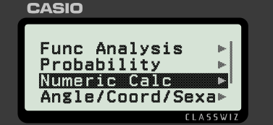

LCM/HCF
Find the LCM of 4 and 6.
Press the ‘Catalog’ button and navigate to ‘Numeric Calc’.
Press ‘EXE’ to see the options.

Slide 31
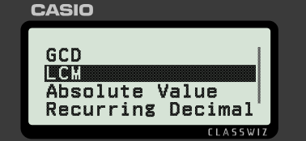
LCM/HCF
Find the LCM of 4 and 6.
Navigate to ‘LCM’.
Press ‘EXE’.

Slide 32
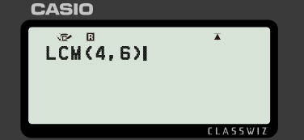
LCM/HCF
Find the LCM of 4 and 6.
Enter the two values. Use a comma to separate the values (‘SHIFT’ button and then the right parenthesis button).
When ready, press ‘EXE’.

Slide 33
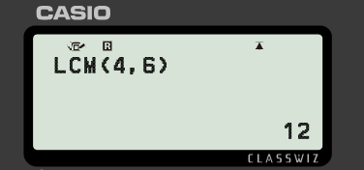
LCM/HCF
Find the LCM of 4 and 6.
The lowest common multiple of 4 and 6 is 12.

Slide 34
LCM/HCF
The fx-83/85GT CW lets you find the LCM of three or more positive integers.
It can find the LCM for two positive integers.

Slide 35
LCM/HCF
You said it can also find the HCF but I didn’t see that option listed.
HCF is referred to as GCD on this calculator.
Aisha
Sam

Slide 36

LCM/HCF
Find the HCF of 12 and 28.
Press the ‘Catalog’ button and navigate to ‘Numeric Calc’.
Press ‘EXE’ to see the options.

Slide 37
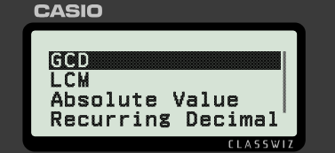
LCM/HCF
Find the HCF of 12 and 28.
‘GCD’ will be selected. This stands for ‘Greatest Common Divisor’.
Press ‘EXE’.

Slide 38
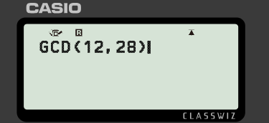
LCM/HCF
Find the HCF of 12 and 28.
Enter the two values. Use a comma to separate the values (‘SHIFT’ button and then the right parenthesis button).
When ready, press ‘EXE’.

Slide 39
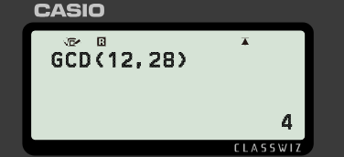
LCM/HCF
Find the HCF of 12 and 28.
The highest common factor of 12 and 28 is 4.

Slide 40
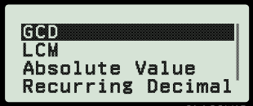
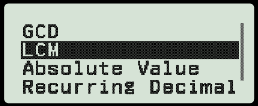
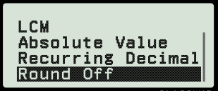
LCM/HCF
Which option should be selected if we want to find the HCF?

Slide 41
LCM/HCF
1) On the next slide is a cross number. Use the clues (and your calculator) to complete the cross number.
When you have finished, enter the numbers, left to right, from the shaded squares into your calculator and turn it upside down.
Write down the name you have found.

Slide 42
LCM/HCF
Across 1) LCM of 13 and 15
3) HCF of 15 096 and 52 836
5) LCM of 13 and 9
6) LCM of 49 and 122
7) HCF of 289 and 867
8) LCM of 36 and 16
10) HCF of 2032 and 2794
11) LCM of 205 and 754
Down 1) HCF of 3162 and 5270
2) LCM of 6086 and 8429
3) HCF of 31 008 and 85 272
4) LCM of 9214 and 9753
8) HCF of 3440 and 5160
9) LCM of 9 and 19
1
2
3
4
5
6
7
8
9
10
11

Slide 43
LCM/HCF
1) On the next slide is a cross number. Use the clues (and your calculator) to complete the cross number.
When you have finished, enter the numbers, left to right, from the shaded squares into your calculator and turn it upside down.
Write down the name you have found.

Slide 44
LCM/HCF
Across 1) LCM of 13 and 15
3) HCF of 15 096 and 52 836
5) LCM of 13 and 9
6) LCM of 49 and 122
7) HCF of 289 and 867
8) LCM of 36 and 16
10) HCF of 2032 and 2794
11) LCM of 205 and 754
Down 1) HCF of 3162 and 5270
2) LCM of 6086 and 8429
3) HCF of 31 008 and 85 272
4) LCM of 9214 and 9753
8) HCF of 3440 and 5160
9) LCM of 9 and 19
The name is Bill. (7718)
1 | 9 | 5 |  | 7 | 5 | 4 | 8
0 |  | 1 | 1 | 7 |  |  | 9
5 |  | 2 |  | 5 | 9 | 7 | 8
4 |  | 9 |  | 2 |  |  | 6
 | 2 | 8 | 9 |  | 1 | 4 | 4
1 |  | 8 |  |  | 7 |  | 1
7 |  | 9 |  |  | 2 | 5 | 4
1 | 5 | 4 | 5 | 7 | 0 |  | 2
1
2
3
4
5
6
7
8
9
10
11

Slide 45
Using the fx-83/85GT CW for number
The fx-83/85GT CW can perform basic calculations and more.
It can convert between different formats for values.
It can quickly calculate the LCM or HCF for a pair of positive integers.

Slide 46

© Oak National Academy 2025.
Produced in partnership with Casio and Mathematics in Education and Industry.
Licensed on the Open Government Licence v3.0, except where otherwise stated. See Oak terms and conditions.

